Slide 1
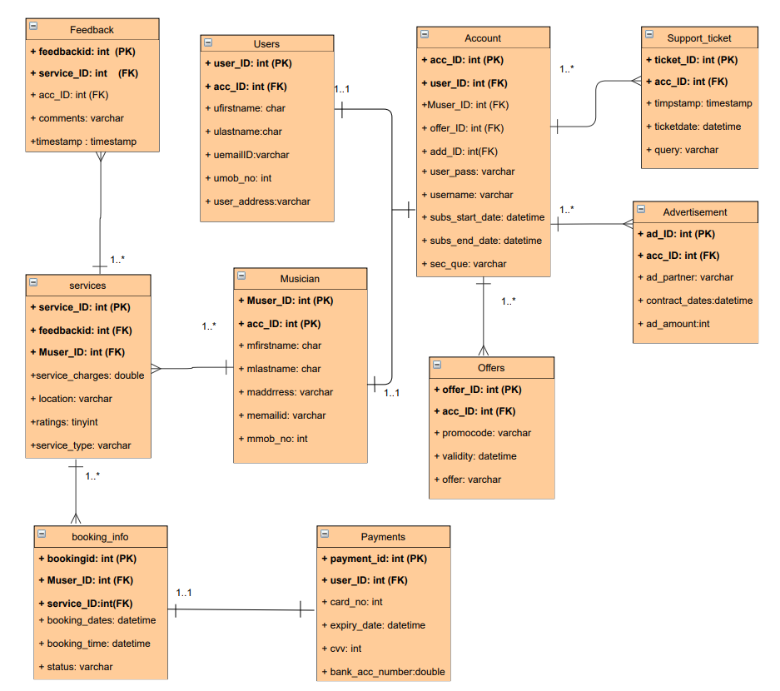
United Tunes ERD
Logical

Slide 2
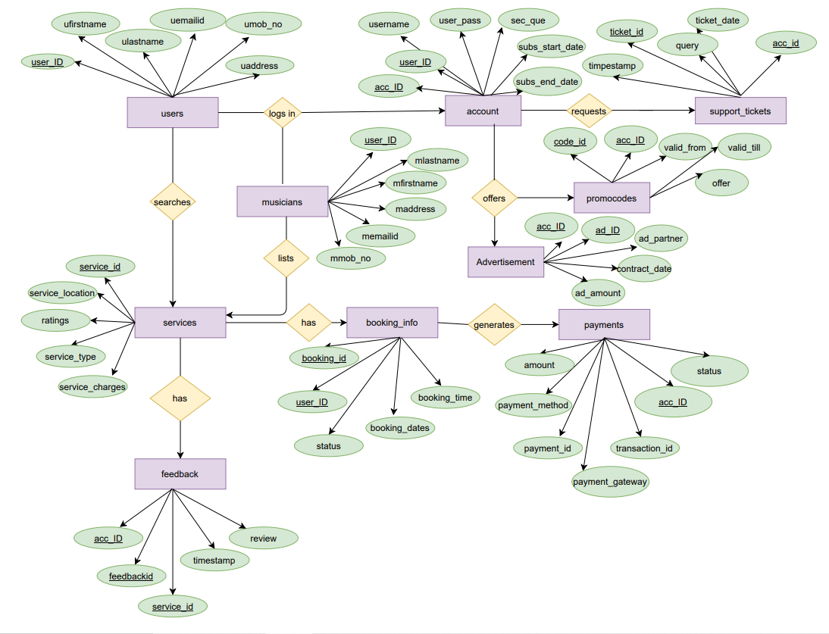
United Tunes ERD
Conceptual

